Slide 1
ICC T20 Data Analysis

Slide 2
The problem
Team Performance
Player Performance
The performance of the team as a whole in the tournament against other teams indicating it’s progress in the league.
Gives us an insight on the team’s weakness, strengths and challenges.
Individual player performances help us analyse how well the player can be exploited by the team in specific conditions to perform exceptionally well be it batsman, bowler or all rounder.

Slide 3
Data Exploration
.Team Performance

Slide 4
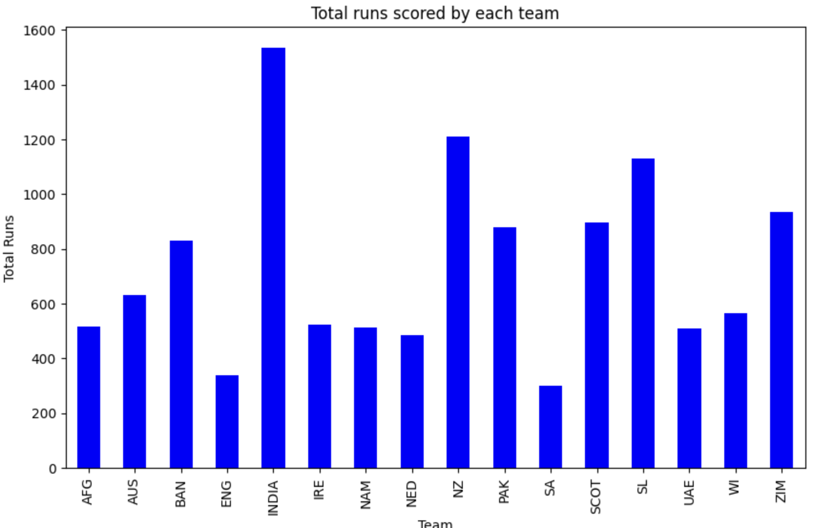
First we analyse the total runs scored by each team.
On plotting the bar graph, we find that India leads the chart followed by New Zealand and Sri Lanka.
It lets us know the batting strength of each team .

Slide 5
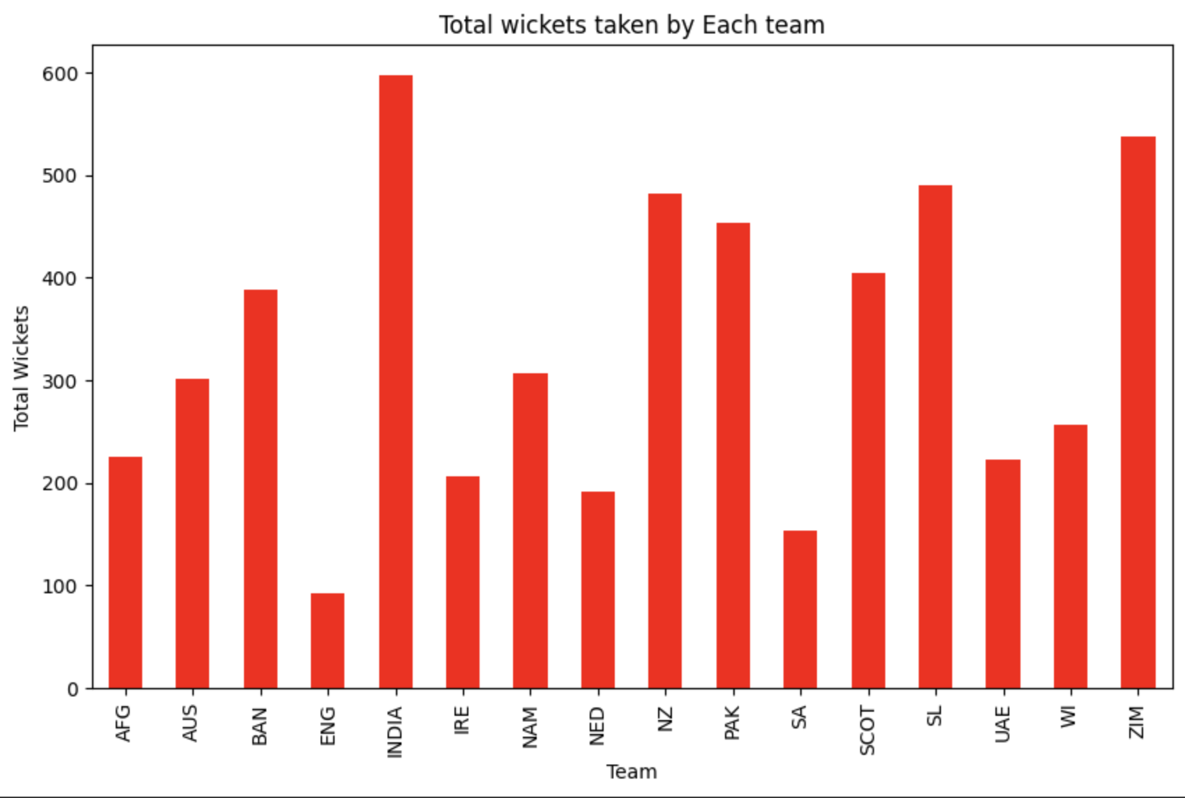
Analysing the wickets taken by each team next, we determine how well each team’s bowling attack is with respect to the other teams.
On plotting the bar graph, we find that India once again leads the chart followed by Zimbabwe and Sri Lanka.

Slide 6
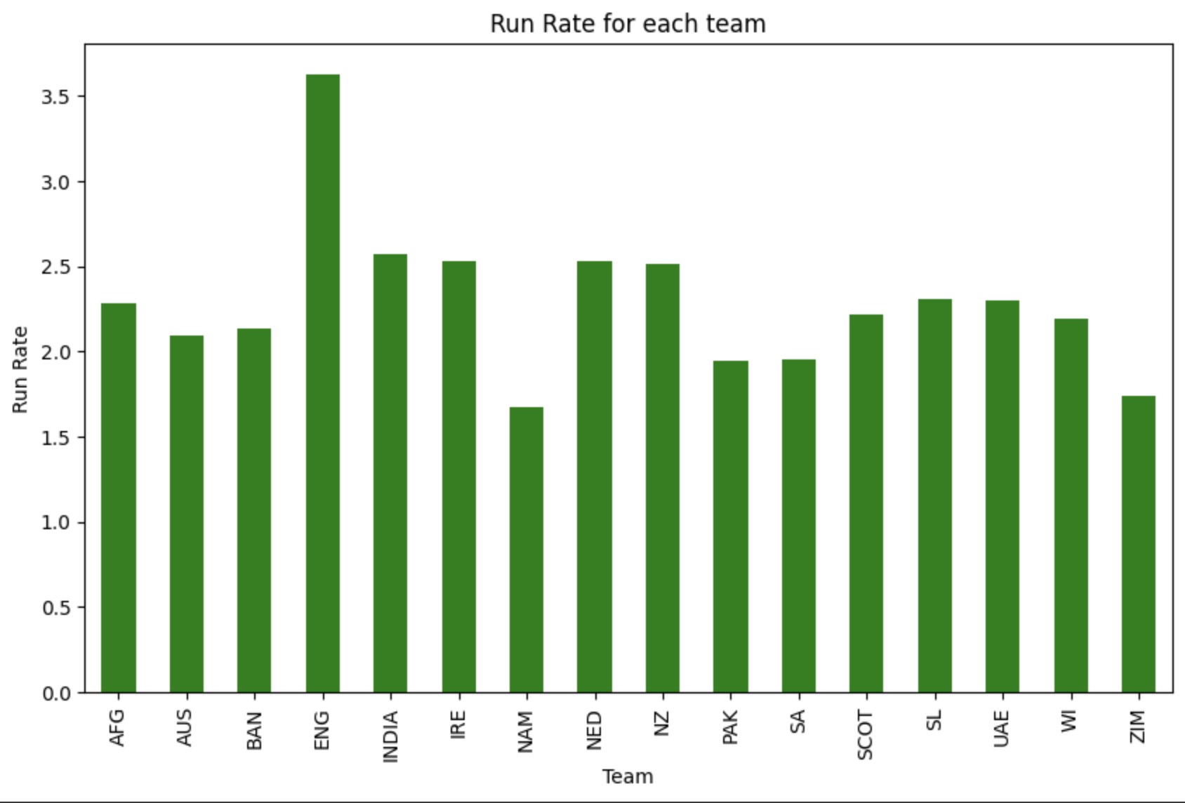
Next, we come to the run rate trends of each team.
It is important to have a high run rate in T20 in every match.
It lets us know the batting consistency of each team .

Slide 7
Data Exploration
Player Performance

Slide 8
First we analyse the total runs scored by each player.
On plotting the bar graph, we find that Virat Kohli leads the chart.
It lets us know the batting powerhouses of each team .

Slide 9
Analysing the wickets taken by each player next, we determine how well each team’s bowling attack can be exploited.
The statistics show that Blessing Muzarabani and Arshdeep Singh.

Slide 10
Next, we come to the all round performance of each player.
It helps us arrive at a conclusion on the basis of how all rounded a team is with respect to batting and bowling.

Slide 11
Subsequently, the economy rate of each bowler is plotted.
It is important to have a low economy rate with more number of wickets in order to be an asset to the team.
Just like the economy rate for bowlers, batsman need to have a high strike rate especially in such a short dynamic and breathtaking 20 over format.

Slide 12
Identifying key events in the match

Slide 13
Key events in the match
Boundaries and sixes
Wickets
Powerplay and change in run rate
There are over a 1200 humongous magnitude of fours and over a massive 350 number of sixes hit in this exciting short tournament.
There has been a high wicket fall in the beginning and death overs than in the middle overs due to pressure on either team in the match.
Powerplay score have been significant in determining the total number of runs.
The run rate has seen a decline in the middle overs and has progressed during powerplay and death overs.

Slide 14
Subsequently, the economy rate of each bowler is plotted.
It is important to have a low economy rate with more number of wickets in order to be an asset to the team.
Just like the economy rate for bowlers, batsman need to have a high strike rate especially in such a short dynamic and breathtaking 20 over format.

Slide 15
The 14th, 19th and 20th overs have been major strategic game changers in most of the matches.
The 14th over is when the last powerplay begins.
The 19th over has been the highest scoring over throughout the format
The 20th over has been known for both wicket taking and run scoring.

Slide 16
Major insights and conclusions
The 14th, 19th and 20th overs have been major strategic game changers in most of the matches.
It is important for a team to maintain a steady run rate during the middle overs.
It is important not to bowl full tosses or bouncers during death overs as they are smashed to the boundaries.
Teams like England have a very high consistency than any other team in this tournament though they haven’t got the stats high in runs or wickets.
It is important for bowlers to maintain low economy.
It is important for batsmen to maintain a high strike rate.
The all rounders must contribute both with the bat and ball.
Not losing wickets during the beginning of the matches is very important.
Yorkers must be dealt with utmost consciousness as they may lead to loss of wicket in this format.

Slide 17
Thank You
max growth

